Slide 1
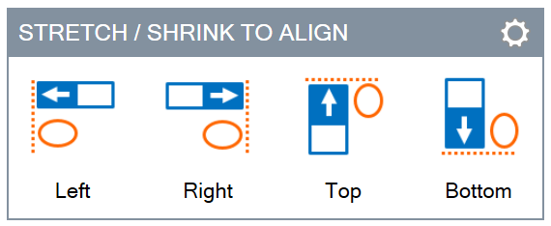
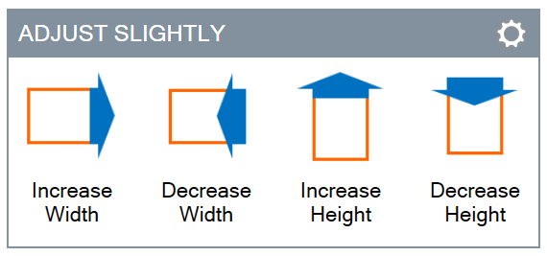
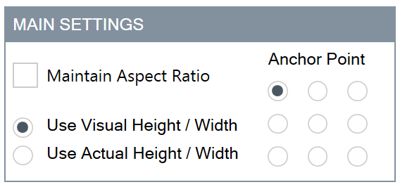
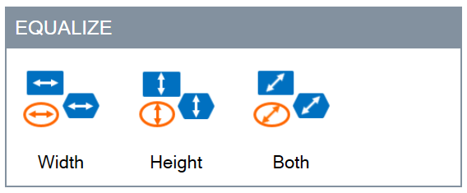
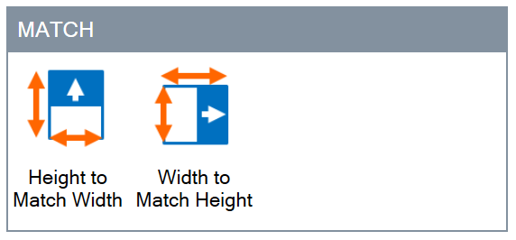
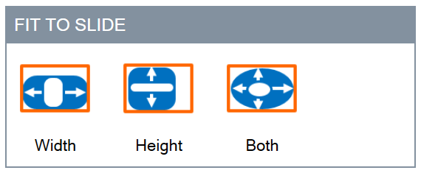
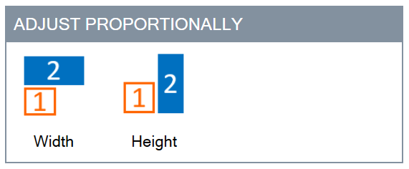
Panel

Slide 2
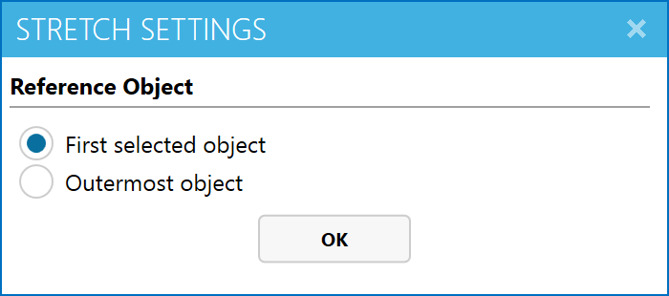
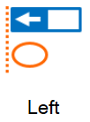
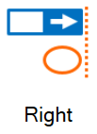


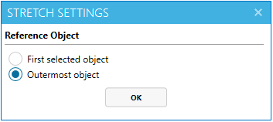
Stretch / Shrink

Slide 3
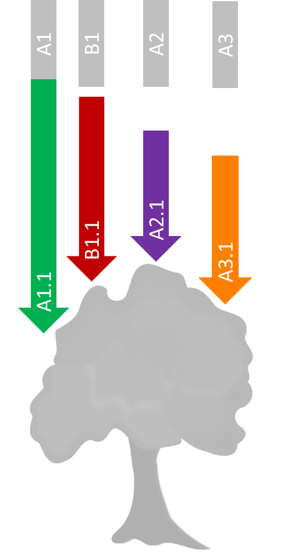
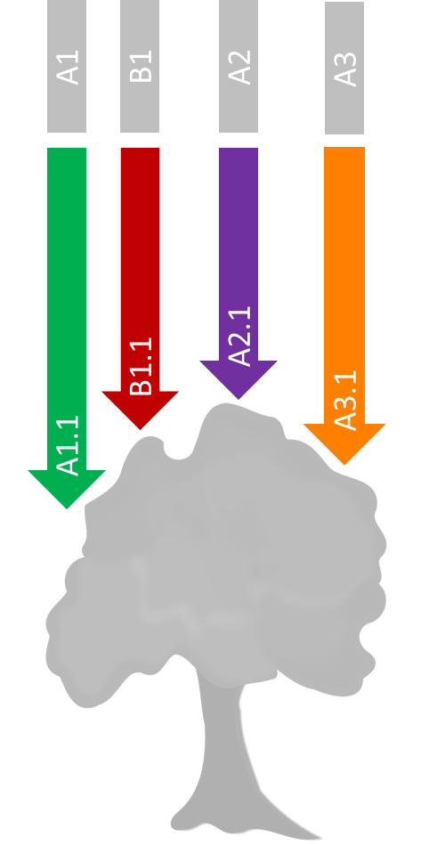
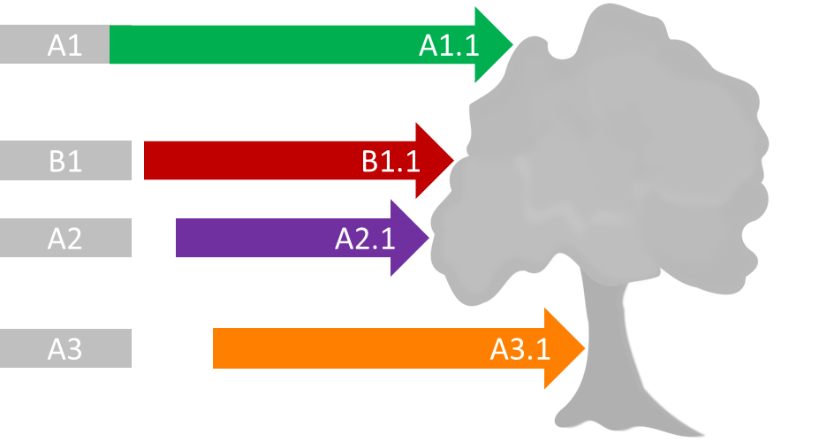
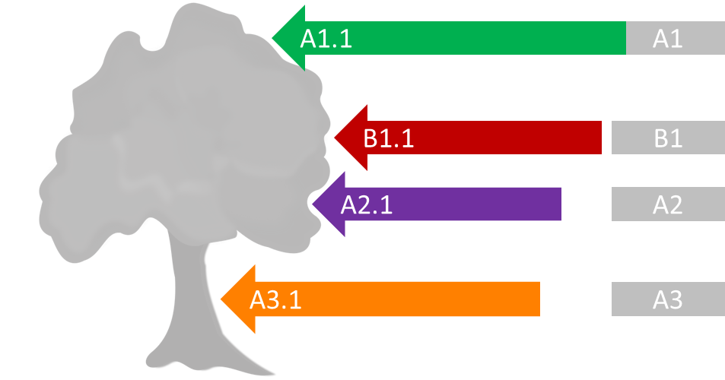
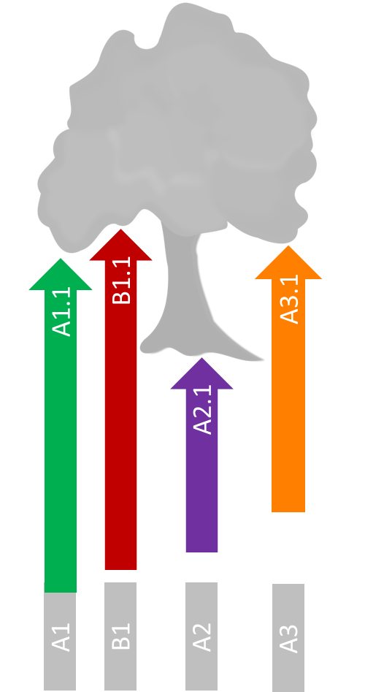
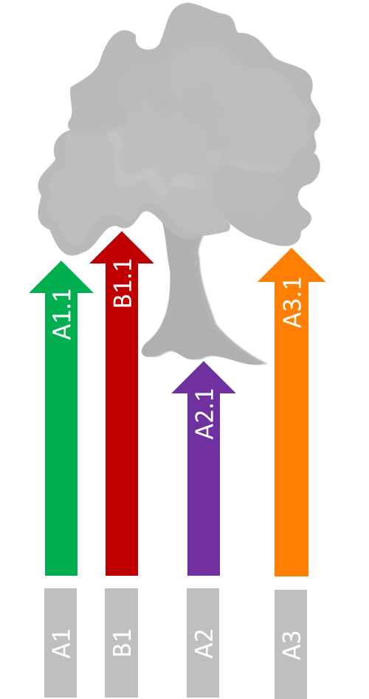
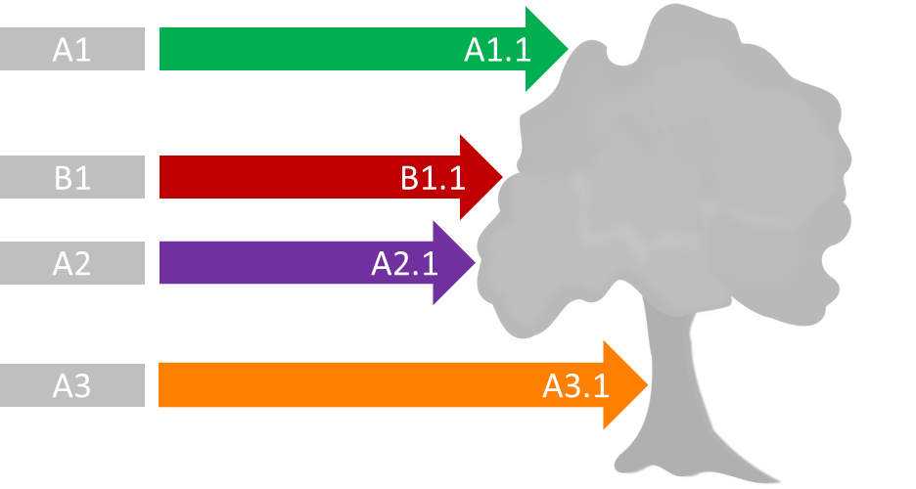
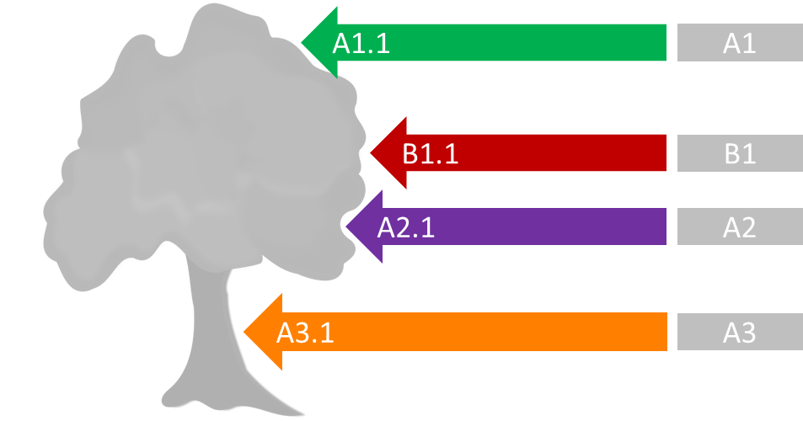
Example
Notes:
Unlock aspect ratio
Reference object: B1.1

Slide 4

A1
A1.1
B1
B1.1
A2
A2.1
A3
A3.1
Outermost object stretch
First selected object stretch
A1.1
A1
A1.1
A1
B1.1
B1
B1.1
B1
A2.1
A2
A2.1
A2
A3.1
A3
A3.1
A3
Notes:
Reference: B1.1 arrow
Stretch Left

Slide 5
A1.1
A1
B1.1
B1
A2.1
A2
A3.1
A3
A1.1
A1
B1.1
B1
A2.1
A2
A3.1
A3
Notes:
Reference: B1.1 arrow
Stretch Right

Slide 6
A1
B1
A2
A3
A1
B1
A2
A3
B1.1
A2.1
A2.1
B1.1
A3.1
A1.1
A1.1
A3.1
Notes:
Reference: B1.1 arrow
Stretch Top

Slide 7
A3.1
B1.1
B1.1
A1.1
A3.1
A1.1
A2.1
A2.1
A1
B1
A2
A3
A1
B1
A2
A3
Notes:
Reference: B1.1 arrow
Stretch Bottom

Slide 8
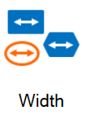
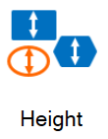
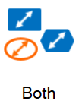
Equalize

Slide 9
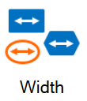
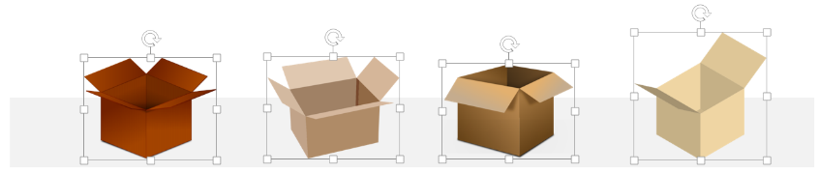
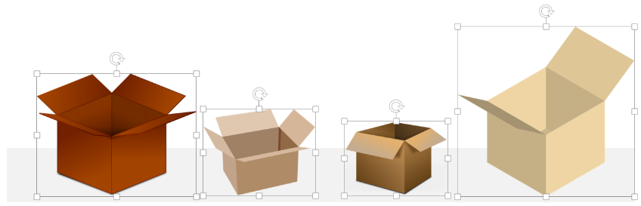
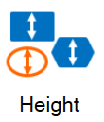
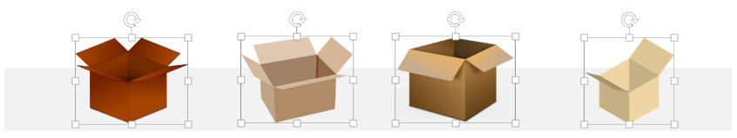
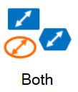
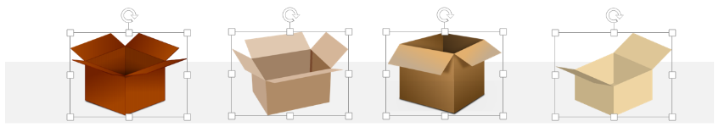
Example
Notes:
Lock Aspect Ratio
Anchor bottom center

Slide 10

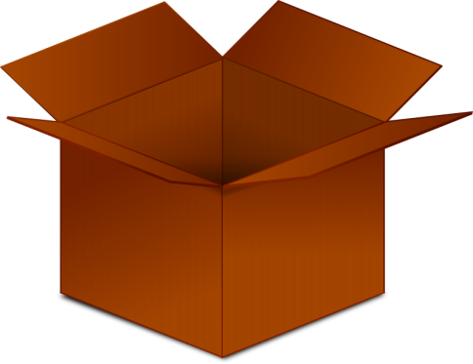
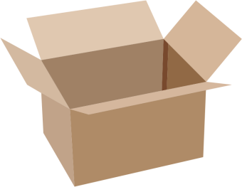
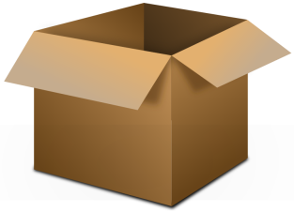
Notes:
Original

Slide 11


Notes:
Lock aspect ratio
Anchor bottom center
Equalize Width

Slide 12


Notes:
Lock aspect ratio
Anchor bottom center
Equalize Height

Slide 13

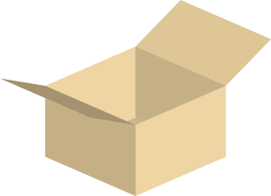
Notes:
Anchor bottom center
Equalize Both

Slide 14
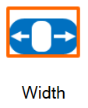
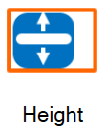
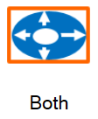
Fit To Slide

Slide 15
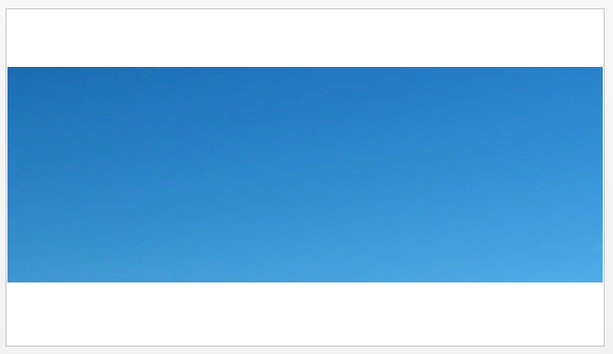
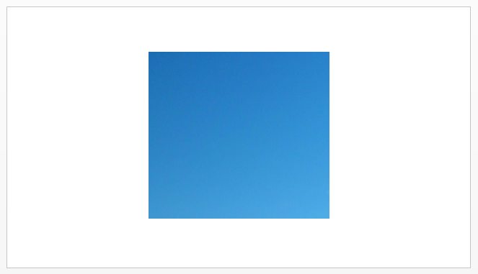
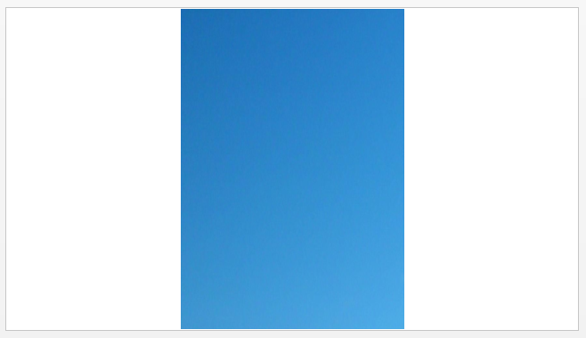
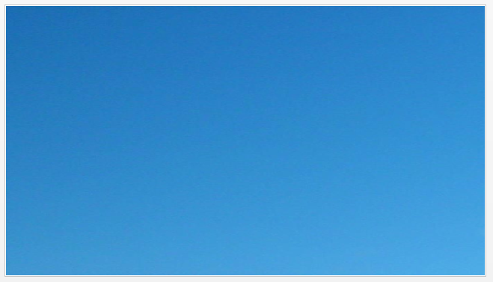
Example
Notes:
Unlock aspect ratio

Slide 16
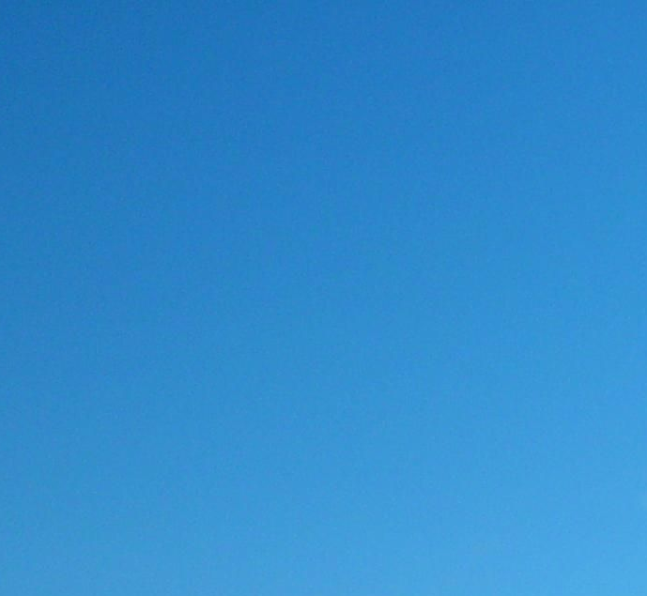

Slide 20
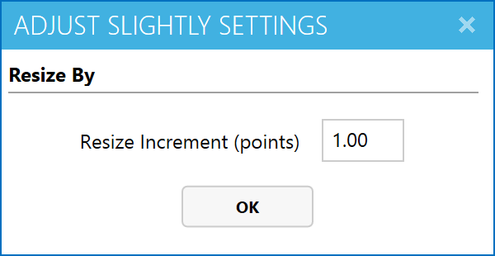
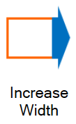
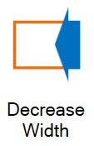
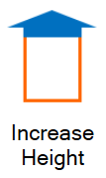
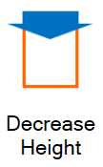
Adjust Slightly

Slide 21
Example
Notes:
Unlock aspect ratio
Anchor bottom center

Slide 22
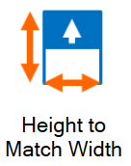
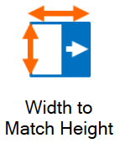
Match

Slide 23
Example

Slide 24
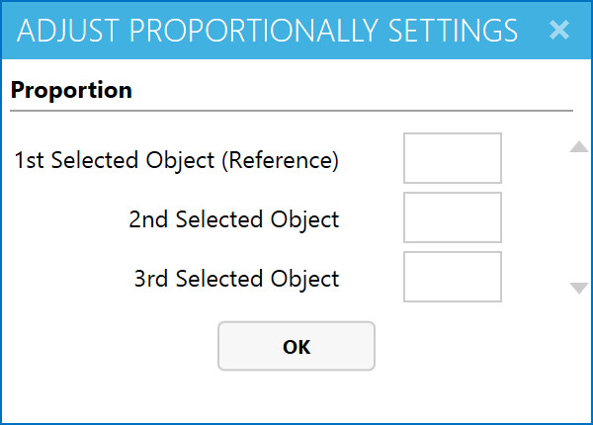
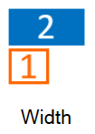

Adjust Proportionally

Slide 25



Example
Notes:
Lock aspect ratio
Adjust proportionally
Anchor bottom center

Slide 26



3911
4000
3000
2870
2000
1980
1000
1995
2005
2015
Giraffe population over the years
Notes:
Origin

Slide 27


3911
4000
3000
2870
2000
1980
1000
1995
2005
2015
Giraffe population over the years
Notes:
Lock Aspect Ratio
Anchor bottom center

Slide 28















Main Setting

Slide 29



Example
Notes:
Image taken from: https://upload.wikimedia.org/wikipedia/en/3/3a/Beagle_puppy.jpg

Slide 30
Example

Slide 31
Example
Actual Height
Visual Height
Actual Width
Visual Width

Slide 32
Example

